Slide 1
First Intermediate Presentation: Reinforcement learning of action sequences in table football
Alexandros Kyrloglou
Guidance: Wannes Meert Jens Bürger
Wen-Chi Yang

Slide 2
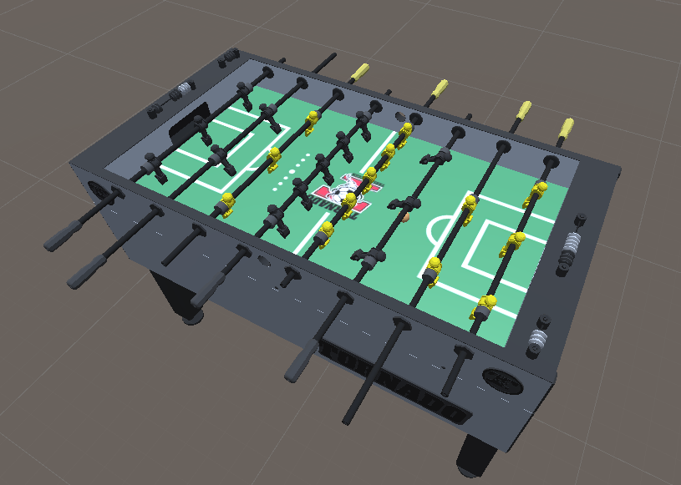
Context & Motivation
Development of robotic foosball.
Benchmark for any Reinforcement Learning implementation.
Nature of the game: no RNG, not only reactive, continuous environment, adversarial.
From theoretic RL implementation to real life robotic implementation.

Slide 3
Problem statement
Goal is passing between controllable players.
Types of passes:
Ball control
Pass static opponent
Pass dynamic opponent
Different rails
Metrics: speed/time, accuracy to the end position (speed at that position), success rate (opponent type).
Get ball to shooting position from goalkeeper.

Slide 4
Methodology
Tools:
Unity (ML-agent)
C# controller + python (Stable Baselines)
Methods:
Model-free Q-Learning.
DRL:
Deep Q-Learning (E-Greedy).
Deep Policy Network.
Discrete Agent actions: (min-max)
Rotation.
Translation.
Continuous Environment:
Ball Position (x,y,z).
Ball Speed.
Current position of players/enemies.
Rewards:
Ball reaching location.
Distance to location.
Speed at location.

Slide 5
Planning
Set up the simulation environment (unity project working properly)
Set up controllable agents
Define states, actions, rewards, metrics etc.
Define promising RL approaches
Implement direct pass with different methods as baseline.
Implement different passes and optimize performance
Determine best working methods
Create sequences that work vs different players: Get the ball from the goalkeeper to a scoring location.

